Slide 1
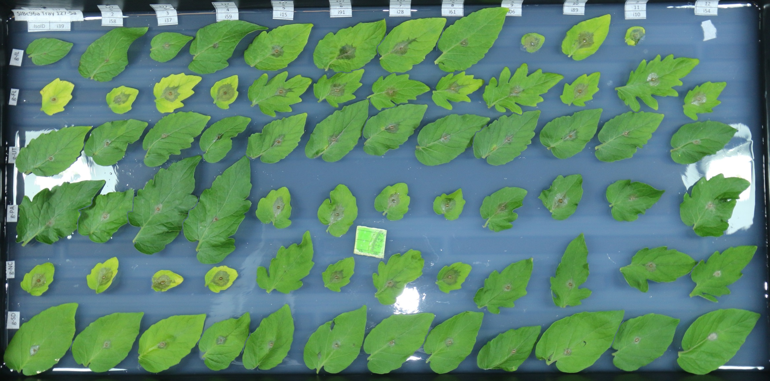
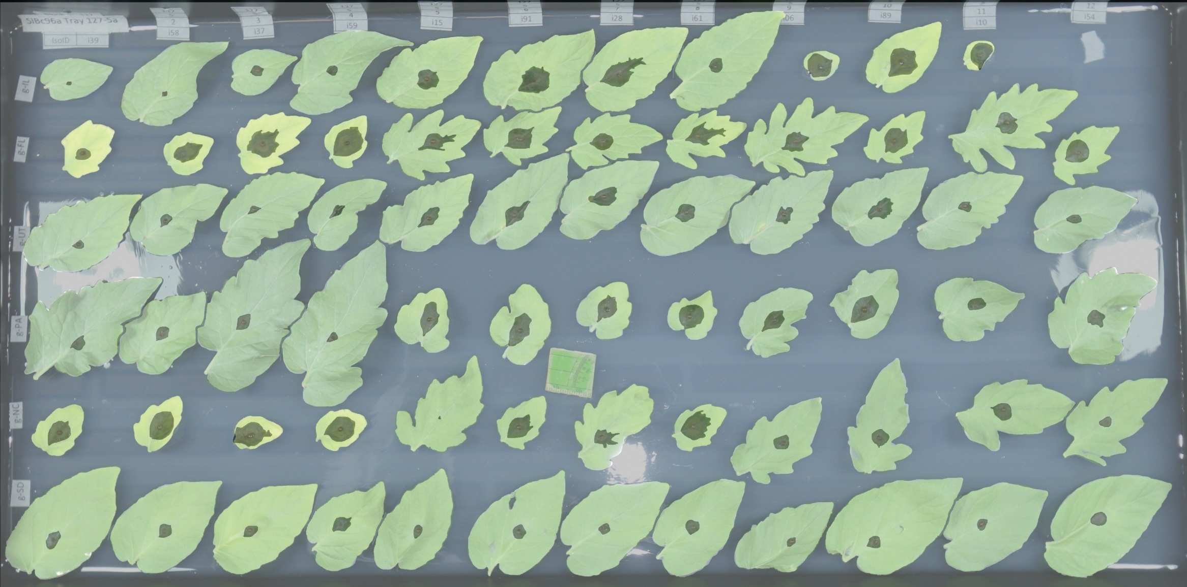
A
B
Notes:
Figure R1. Botrytis cinerea x tomato detached leaf assay and digital image analysis. Individual tomato leaflets of 6 S. lycopersicum genotypes and 6 S. pimpinellifolium genotypes are in randomized rows, spore droplets of individual B. cinerea isolates are in randomized columns. Digital images are collected 72 hours post inoculation.
A) Single droplets of 40 B. cinerea spores are infected on randomized leaflets using randomized isolates, and digital images are taken 72 hours post inoculation.
B) Digital masking of leaf and lesion is followed by automated measurement of area for each lesion.

Slide 2
Notes:
Figure R2. Distribution of tomato genotype susceptibility to infection with 91 genetically diverse B. cinerea isolates.
Violin plots show the distribution of lesion size caused by B. cinerea isolates on each tomato host genotype. Individual points are mean lesion size for each of the 97 different isolate-host pairs. The boxes show the 75th percentile distribution, and the horizontal line shows the mean resistance of the specific host genotype. The tomato genotypes are grouped based on their status as wild or domesticated germplasm.

Slide 3
Notes:
Figure R3. Distribution of B. cinerea virulence by tomato domestication status.
The violin plots show the mean virulence of each B. cinerea isolate on the tomato genotypes, grouped as wild or domesticated germplasm. The domestication effect on lesion size is significant (Table R1 ANOVA, p<2e-16). The interaction plot between the two violin plots connects the average lesion size of a single B. cinerea isolate between the wild and domesticated germplasm.

Slide 4
A
B
C
D
E
F
Notes:
Figure R4. Highlighted variance of diversity in B. cinerea x tomato interctions.
Shown is an interaction plot of lesion size due to individual B. cinerea isolates on all of the tomato host genotypes, grouped by domestication status. The x-axis includes each tomato host genotype. Each line traces the average lesion size of a single B. cinerea isolate across hosts.
A) Plot of all isolates.
B) The common reference B. cinerea isolate B05.10 is highlighted in black.
C) The ten highest-virulence isolates, as estimated by mean virulence across all tomato genotypes, are highlighted in black.
D) The ten most saprophytic, or low virulence, isolates, as estimated by mean virulence across all genotypes, are highlighted in black.
E) The five isolates collected from tomato tissue are highlighted in black.
F) The two isolates with significant domestication sensitivity are shown in black.

Slide 5
Notes:
Figure R5. Rank order plot of B. cinerea lesion size on two tomato genotypes.
Each B. cinerea isolate is a straight line tracing mean lesion size on LA1547 to mean on LA0410, the two host genotypes with the most pronounced effect on the lesion size distribution across all isolates (Wilcoxon signed-rank test, p < 7.18e-17, Table R2). Isolate rank order shifts from
LA1547 to LA0410, as most isolates are more virulent on LA0410 but a significant subset reverse this trend. A total of 38 of the 66 plant host pairs display this pattern of shifting isolate rank order.

Slide 6
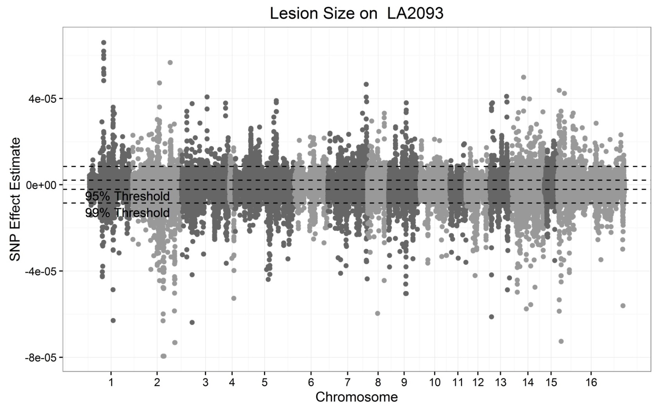
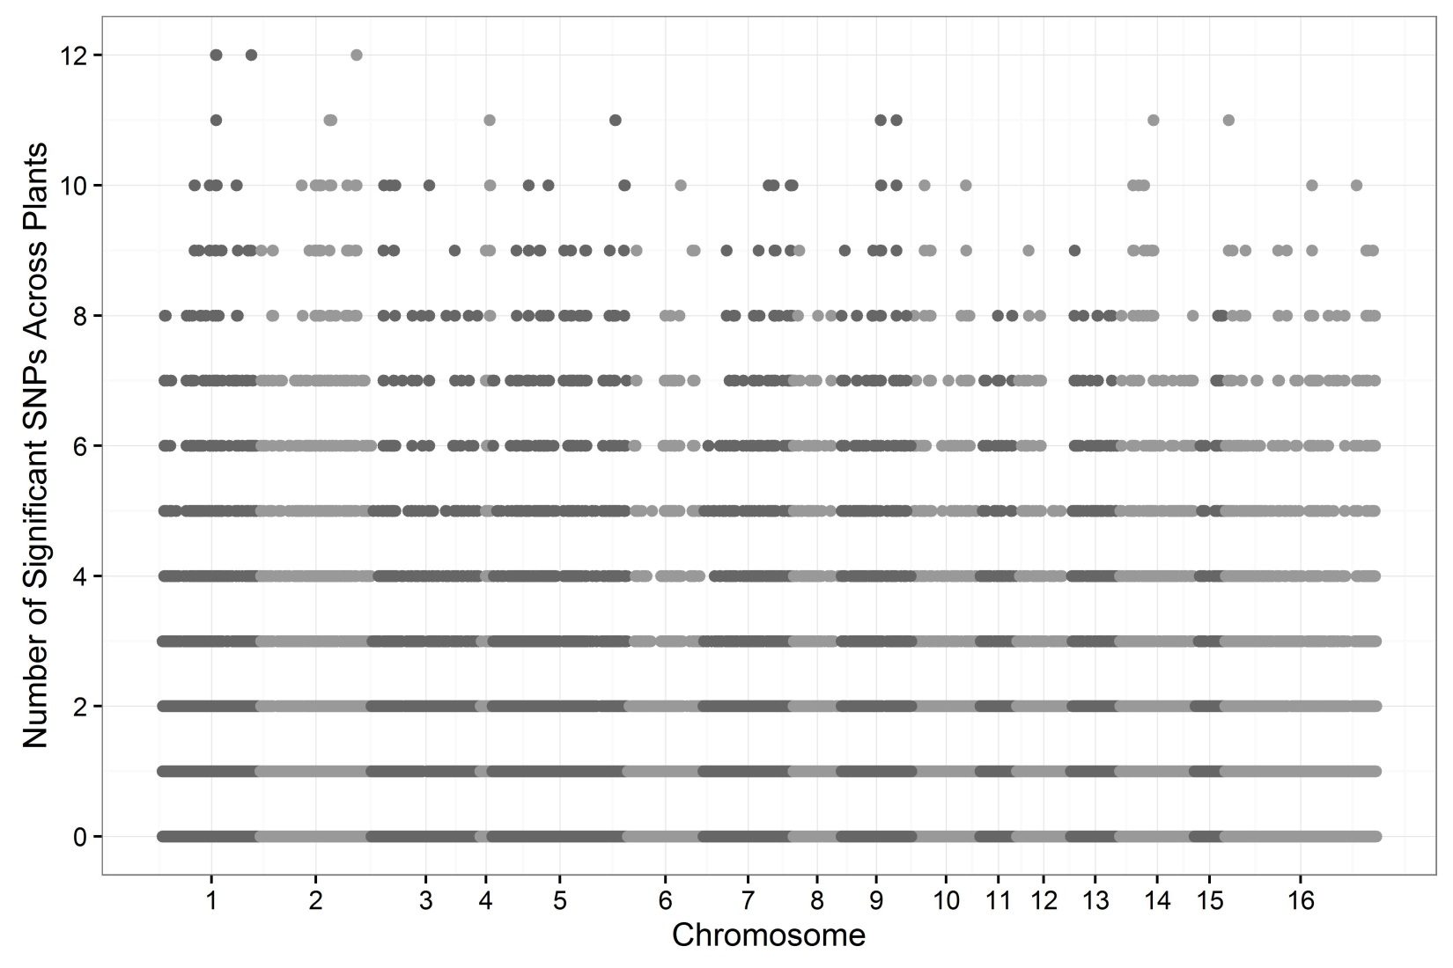
A
B
Notes:
Figure R6. GWA of B. cinerea lesion size on individual tomato genotypes.
Botrytis cinerea chromosomes are differentiated by shading, alternating black and grey.
A) Manhattan plot of estimated SNP effect sizes for B. cinerea lesion size using a single tomato accession, LA2093. Permutation-derived thresholds are shown in horizontal dashed lines.
B) The number of tomato accessions for which a B. cinerea SNP was significantly linked to lesion development using the 99% permutation threshold. Frequency is number of phenotypes in which the SNP exceeds the threshold. Vertical dotted lines identify regions with overlap between the top 100 large-effect SNPs for LA2093 and significance across the majority (≥6) of tomato genotypes tested.

Slide 7
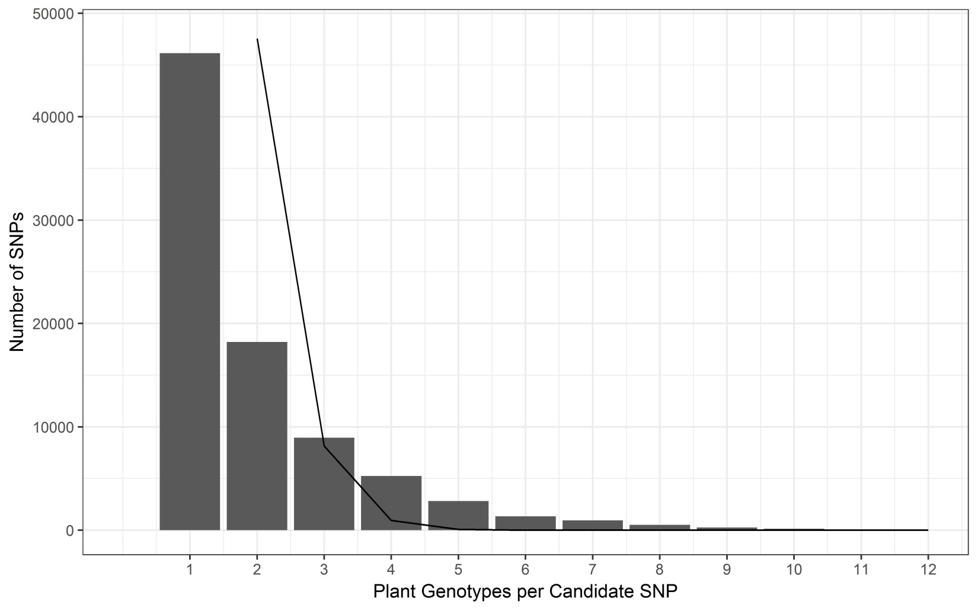
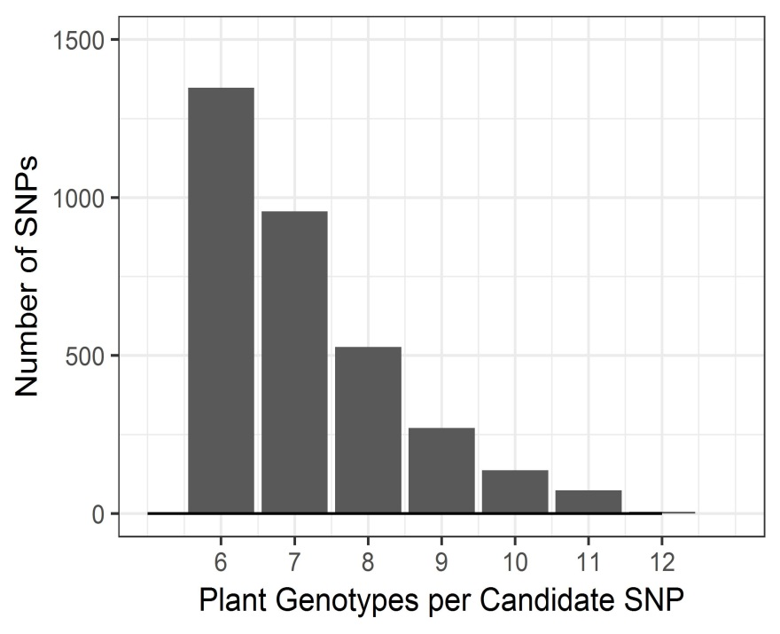
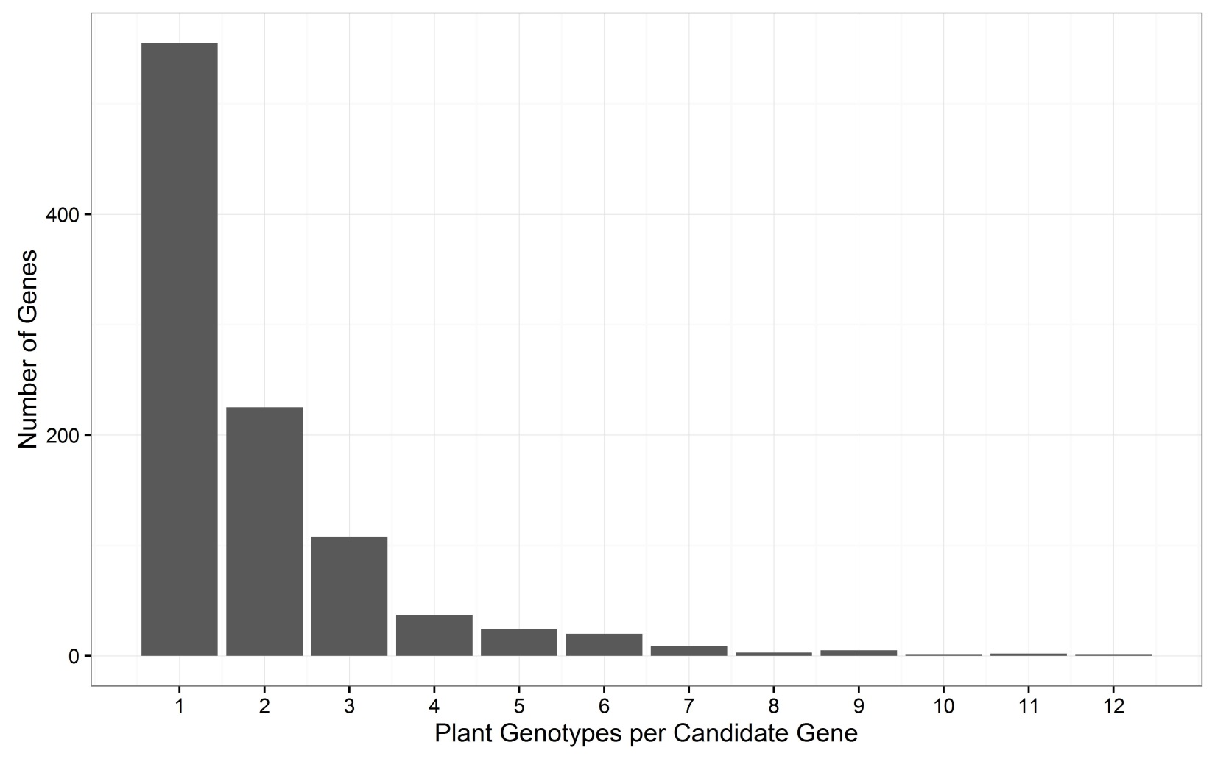
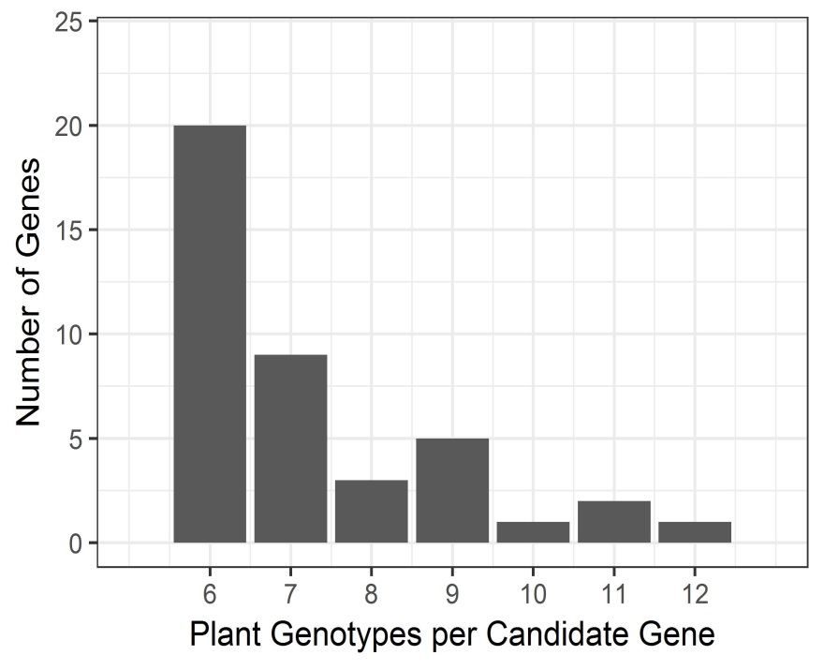
Notes:
Figure R7. Frequency of overlap in B. cinerea GWA significance across tomato accessions.
A) Frequency with which the top 1000 B. cinerea SNPs significantly associated with lesion size on the 12 tomato accessions using the 99% permutation threshold. Black line traces expected frequency of SNP overlap across accessions. Inset shows SNP associations on 6 or more accessions.
B) Frequency with which a B. cinerea gene significantly associated with lesion size on the 12 tomato accessions. Genes were called as significant if there was one significant SNP in the top 1000 called at the 99% permutation threshold within the gene body or within 2kb of the gene body. Inset shows gene associations on 6 or more accessions.

Slide 8
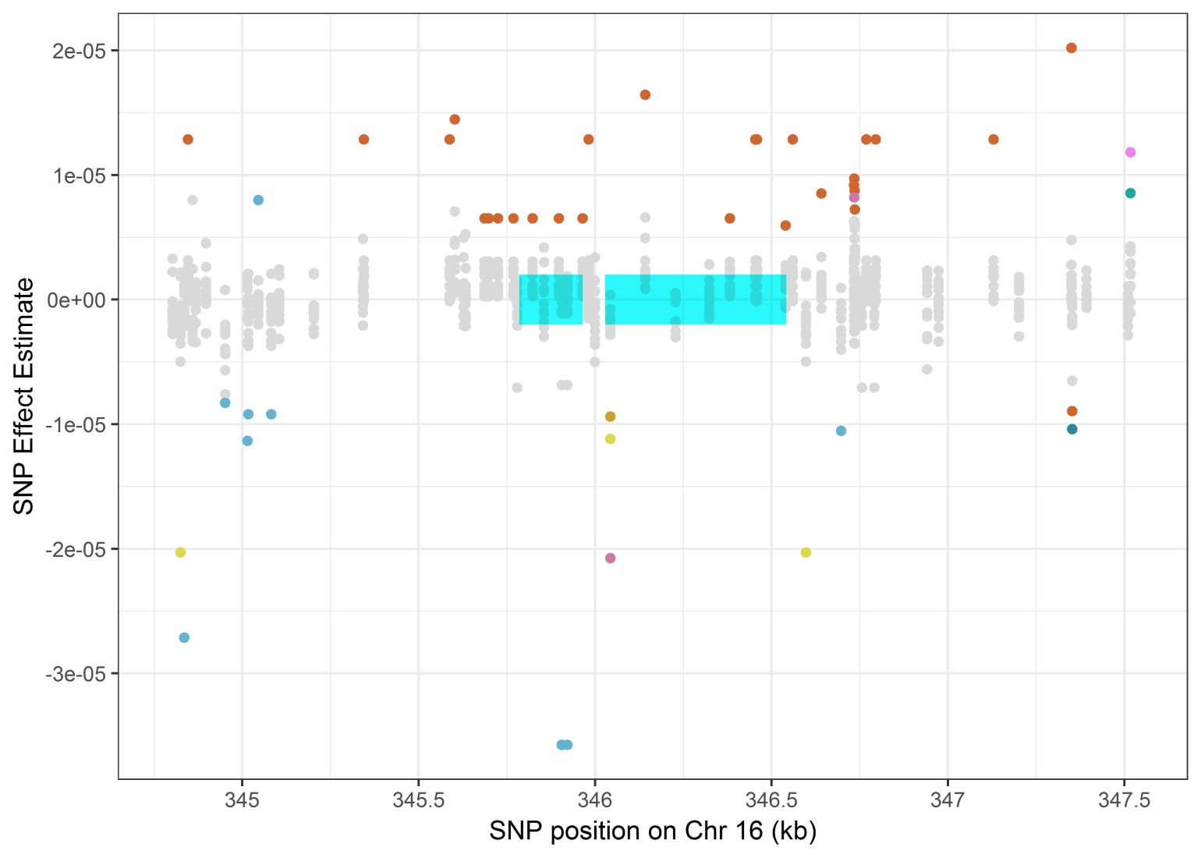
BcT4_4591
Notes:
Figure R8. Host specificity of significant SNPs linked to the gene BcT4_4591.
SNPs with effects estimates above the 99% permutation threshold are colored by trait (plant phenotype in which the effect was estimated). BcT4_4591 is a cerato-platanin gene linked to at least one significant SNP on all 12 of the tested tomato accessions. The annotated exons are depicted as grey rectangles.

Slide 9
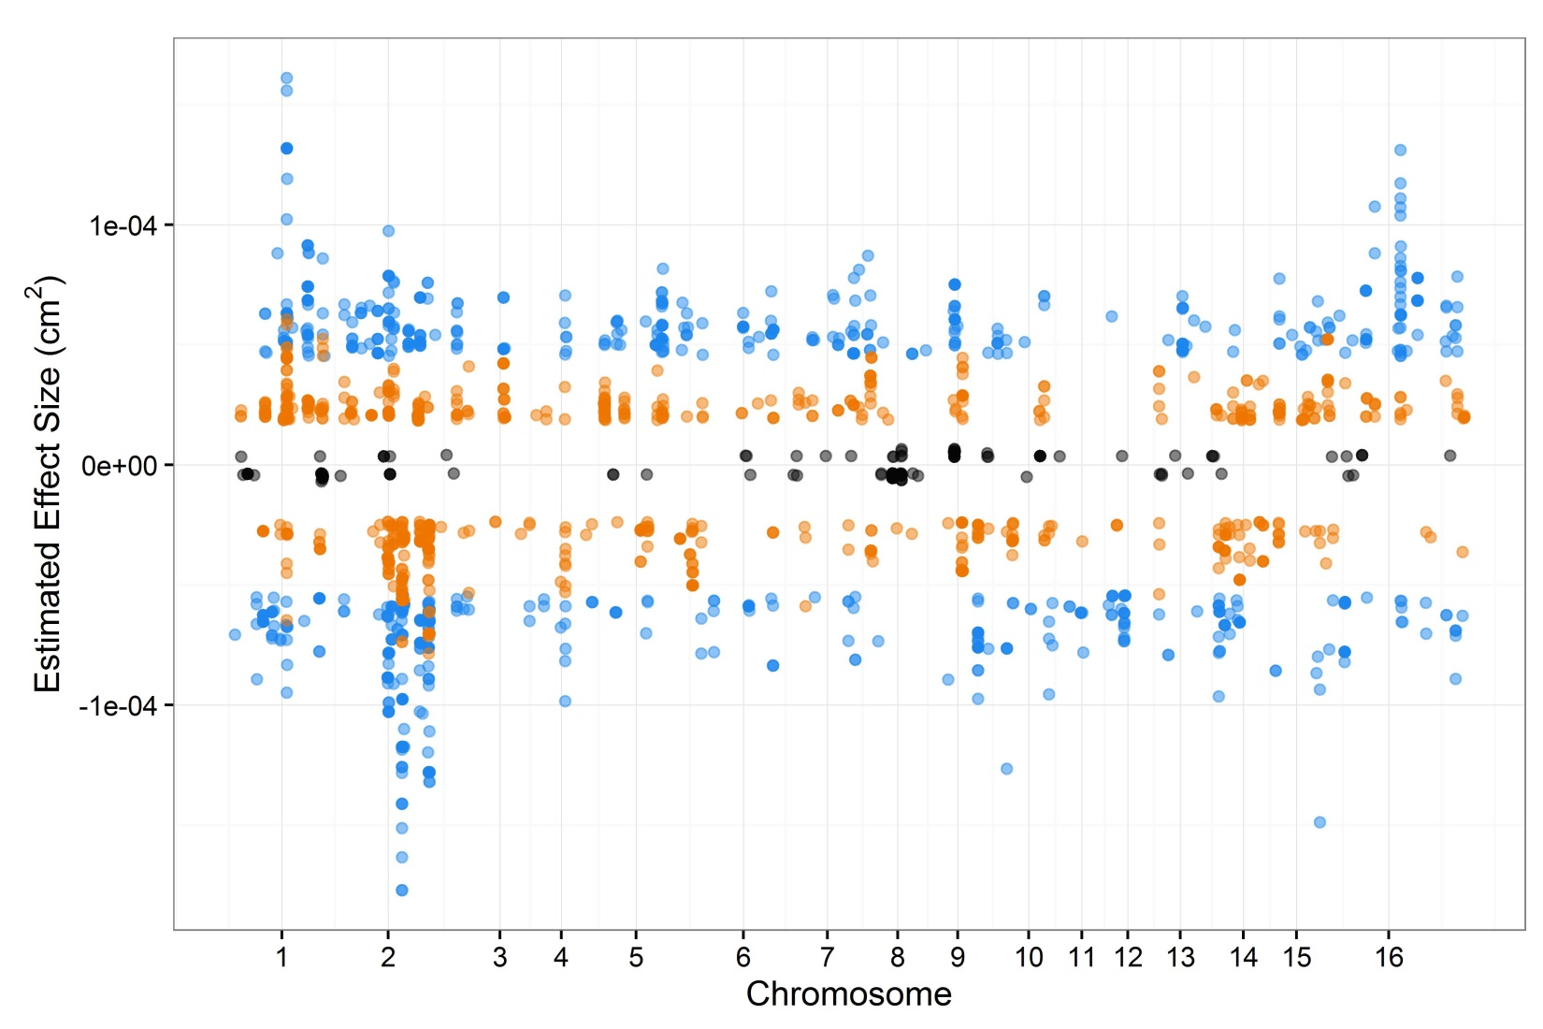
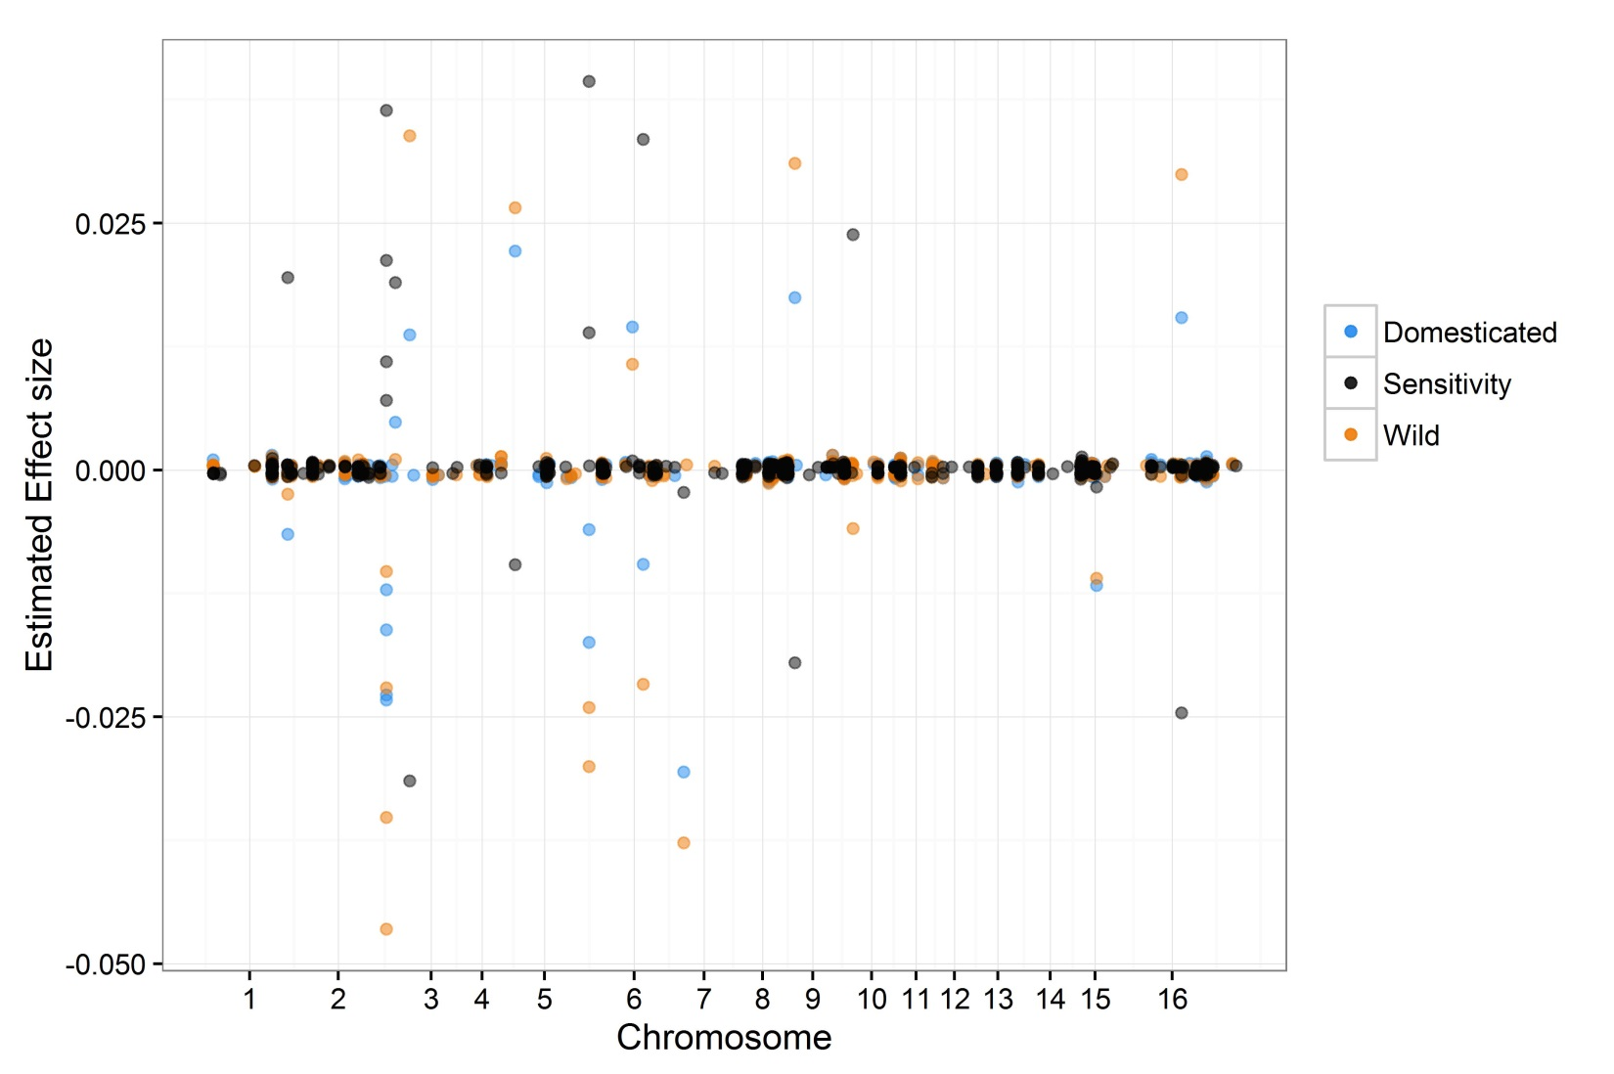
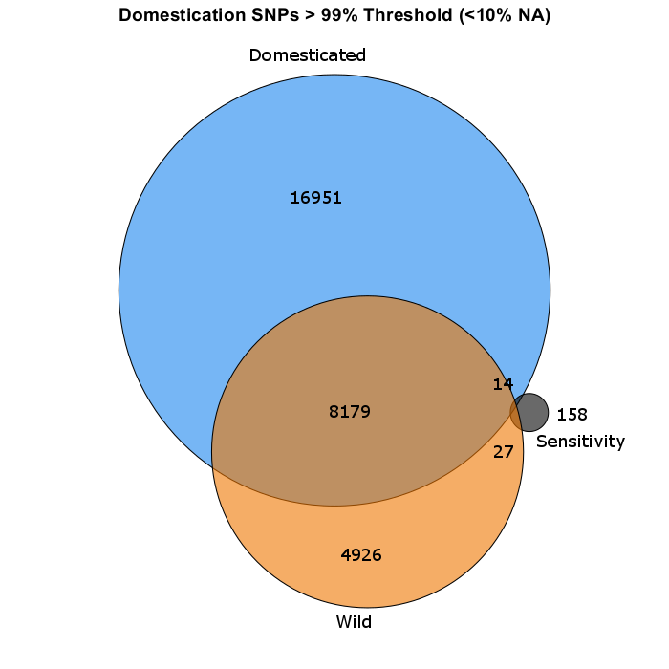
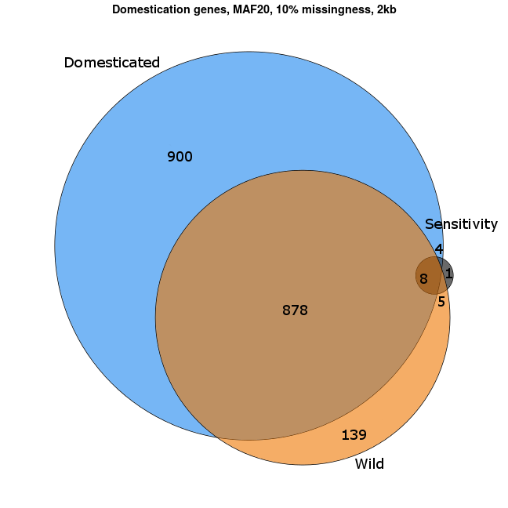
a
b
c
Notes:
Figure R9. GWA analysis of domestication sensitivity in B. cinerea.
Domestication sensitivity of each isolate was estimated using the average virulence on the wild and domesticated tomato germplasm using Sensitivity = (Domesticated lesion size – Wild lesion size) / Domesticated lesion size. This was then utilized for GWA mapping.
A) The top 1000 SNPs that significantly affect lesion size across domesticated tomato, wild tomato or domestication sensitivity are shown. Significance is called as crossing the 99% permutation threshold.
B) Venn diagram of overlapping SNPs identified as crossing the 99% permutation threshold for each trait.
C) Venn diagram of overlapping genes identified as crossing the 99% permutation threshold for each trait. Genes were called as significant if there was one significant SNP within the gene body or within 2kb of the gene body.

Slide 10
Fixed Effect | SS | F value | DF | p
Isolate | 256.63 | 13.54 | 94 | <2e-16
Domestication | 19.45 | 96.4566 | 1 | <2e-16
Domest/Plant | 73.67 | 36.5377 | 10 | <2e-16
Iso:Domest | 20.67 | 1.0905 | 94 | 0.260
Iso:Domest/Plant | 189.51 | 0.9838 | 940 | 0.623
Experiment | 545.73 | 2706.737 | 1 | <2e-16
Exp/Block | 201.02 | 249.2555 | 4 | <2e-16
Exp:Iso | 152.15 | 8.028 | 94 | <2e-16
Exp:Domest | 0.83 | 4.0954 | 1 | 0.043
Exp:Domest/Plant | 47.43 | 23.5267 | 10 | <2e-16
Notes:
Table R1. ANOVA results of the interaction between 12 tomato accessions and 95 B. cinerea isolates measured as lesion area.
The Type III Sums-of-Squares, F-value, Degrees of Freedom and p-value for the linear modelling of lesion area for 12 tomato accessions by 95 B. cinerea isolates is shown. The terms are as follows; Isolate is the 95 B. cinerea isolates, Domestication is wild tomato, S. pimpinellifolium, versus domestic tomato, S. lycopersicum, Plant is 12 tomato genotypes nested within their respective domestication groupings, Experiment tests the 2 independent replicate experiments, Experiment/Block tests the three blocks nested within each experiment. In addition interactions of these factors are tested (:).

Slide 11
 |  | Wild |  |  |  |  |  | Domest
 |  | LA1547 | LA1589 | LA1684 | LA2093 | LA2176 | LA480 | LA2706 | LA3008 | LA3475 | LA410 | LA4345 | LA4355
Wild | LA1547 |  | 3256 | 3975 | 3069 | 2228 | 3006 | 2165 | 3478 | 1847 | 1253 | 3942 | 2970
 | LA1589 | <0.001 |  | 5323 | 4755 | 3566 | 4563 | 3396 | 4860 | 3173 | 2406 | 5491 | 4426
 | LA1684 | 0.086 | NS |  | 4020 | 3008 | 3926 | 2885 | 4194 | 2627 | 1959 | 4776 | 3810
 | LA2093 | <0.001 | NS | NS |  | 3395 | 4575 | 3260 | 4943 | 2919 | 2093 | 5630 | 4384
 | LA2176 | <0.001 | 0.007 | <0.001 | 0.002 |  | 5766 | 4428 | 5955 | 4287 | 3411 | 6670 | 5610
 | LA480 | <0.001 | NS | 0.067 | NS | 0.012 |  | 5939 | 4376 | 6212 | 6999 | 3703 | 4869
Domest | LA2706 | <0.001 | 0.002 | <0.001 | <0.001 | NS | 0.003 |  | 6071 | 4564 | 3785 | 6716 | 5794
 | LA3008 | 0.003 | NS | NS | NS | 0.003 | NS | 0.001 |  | 3062 | 2339 | 5309 | 4283
 | LA3475 | <0.001 | <0.001 | <0.001 | <0.001 | NS | <0.001 | NS | <0.001 |  | 3824 | 7088 | 6022
 | LA410 | <0.001 | <0.001 | <0.001 | <0.001 | 0.002 | <0.001 | 0.030 | <0.001 | 0.037 |  | 7779 | 6820
 | LA4345 | 0.072 | 0.065 | NS | 0.030 | <0.001 | 0.018 | <0.001 | NS | <0.001 | <0.001 |  | 3601
 | LA4355 | <0.001 | NS | 0.034 | NS | 0.032 | NS | 0.010 | NS | 0.002 | <0.001 | 0.009
Notes:
Table R2. Correlation of lesion area caused by the 97 B. cinerea isolates across all of the tomato accessions.
FDR corrected p-values of Wilcoxon signed-rank test comparing mean B. cinerea lesion area on pairs of tomato accessions. Bold text indicates significance at p<0.01 after correction, italicized text indicates suggestive p-values p<0.1 >0.01. NS shows non-significant interactions.

